Slide 1

Personal Knowledge Engine October 11th 2021
Team Name: PK Engineers
Team member names:
Noah Cantwell - Initial Scrum Master
Weston Cook - Product Owner
Rodger Wang
Anupreet Singh
Jason Zheng
Cole Anderson

Slide 2
Personal Knowledge Engine
Ever wasted time searching for some exact line in your notes? Or gone through directories looking for a picture? This is the project for you.
Often we have trouble searching through lots of files to find specific information, personal items, or photographs.
Our software will help with targeted file searching, allowing users to search one or more files by keywords
Will prove advantageous towards anyone who has to search massive amounts of files

Slide 3
Project Scope
GOALS:
Be able to search through multiple files for specific information
Concise user interface for searching
Specify which folders/file types to search/exclude
Include regular expressions search for developers
Search results appear as a list with each element containing the file path and a preview of the part of the file that matches the search
Ability to search for terms outside of exact text matches.
Search image text using OCR
Search images by visual content (e.g. “pictures of the backyard”)
Search images by name (e.g. “pictures with a brand”)

Slide 4
Sprint 1
File Search
user stories each labeled with assoc. high-level goal:
(2) As a student, I want to be able to search through a single file for keywords so I can find important information.
(2) As a student/teacher, I want to be able to search through multiple files for keywords, so I don’t have to search files individually.
(3) As a user, I want to be able to restrict my search to certain file types, or to specific folders, so the search is quicker.
Spikes (exploratory work, usually in preparation of future sprints)
Researching how to store previous searches and how many past searches should be listed.
The ability to pause or cancel a search before completion of the search.
Infrastructure tasks (acquiring tools, setting up environment)
Git Lab (uploading work periodically)
Jira Stories

Slide 5
Sprint 2
UI Design
user stories each labeled with assoc. high-level goal
(3) As a first time user, I want the search function to have an understandable and organized user interface so that I know where information was found and how I can access it.
(2) As a user, I want to see previews of the searched term as it appears in the result files so that I know which files contain useful information.
(2) As a visual person, I want to have some visual feedback that a search is in progress so that I don’t waste time waiting for a search that isn’t in progress.
(1) As someone who makes mistakes, I want to be able to pause or cancel a search before it completes so that I can modify it or avoid wasting time finding information that I don’t need.
Spikes (exploratory work, usually in preparation of future sprints)
Research good UI design.
Research file tracking in the search.
Research on setting up a cache for history tracking and saving.
Infrastructure tasks (acquiring tools, setting up environment)
Photoshop/Illustrator for UI design.

Slide 6
Sprint 3
Search History
user stories each labeled with assoc. high-level goal
(2) As a returning user, I want to be able to see my past searches and their results at the time so that I don’t waste time on unnecessary duplicate searches.
(1) As a user, I want to be able to update the results for my past searches without having to retype them so that it is easier to get up-to-date information.
(5) As a user who values efficiency, I want my files to open to a relevant area when I click on them in the search results so that I don’t have to find them manually.
(8) As a computer-illiterate user, I want to be able to search using natural language, or text outside of the exact terms I want to find so that I can still find what I need even if I don’t know exactly how it’s phrased.
Spikes (exploratory work, usually in preparation of future sprints)
Research into image recognition software.
Image categorization for easier search (ie. tags).
Infrastructure tasks (acquiring tools, setting up environment)
Memory/Storage.

Slide 7
Sprint 4
Stretch Goals
user stories each labeled with assoc. high-level goal
(5) As someone with limited time, I want my searches to utilize cached condensed file content to speed up search times. (Tentative)
(3) As a power user, I want to be able to manage the amount of storage the program is allowed to use for caching.
(8) As a researcher/photographer I want searches to include text in images so that I don’t have to manually run OCR tools on them first. (Tentative)
(13) As a photographer, I want to be able to search images by the kind of items in the image so that I can find specific images without having to look through them myself. (Tentative)
Spikes (exploratory work, usually in preparation of future sprints)
Text in images also visible in search results.
View images as results related to the text search. (Ex. Bike images should show up when searching “Bike”.)
Infrastructure tasks (acquiring tools, setting up environment)
Optical character recognition software.
Embedding software tool into the PKE.

Slide 8
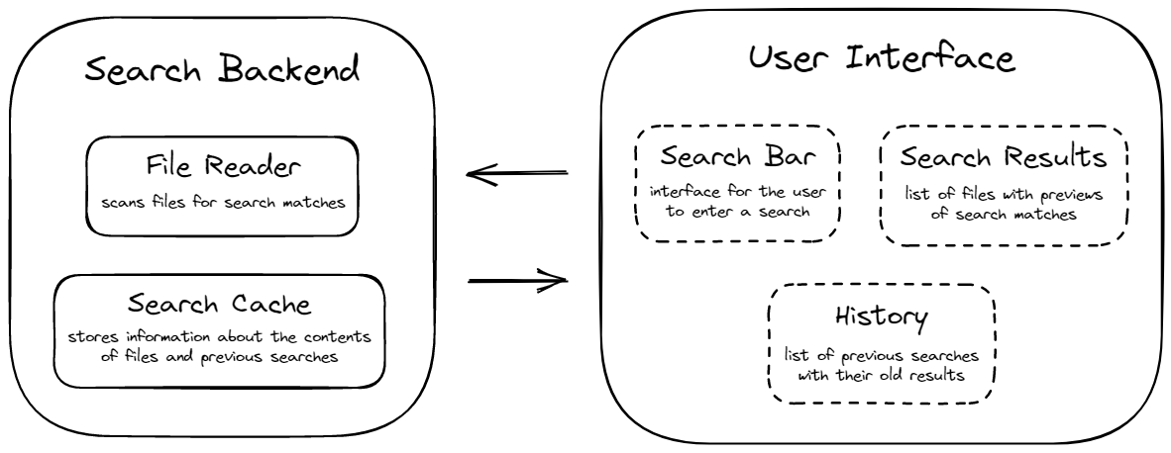
Architecture

Slide 9






Technologies

Slide 10
Challenge/Risk 1
Large scope:
Due to the large scope of this project, and the many possible directions in which features could be added, a possible challenge would be maintaining a reasonable project scope, while continuing to challenge ourselves.

Slide 11
Challenge/Risk 2
Unfamiliar technology:
While members of the group are all versed in Python, many of the supporting technologies and libraries we will be using are unfamiliar to us. Working with technologies like image recognition and natural language processing will be tough without training in those specific areas.

Slide 12
Challenge/Risk 3
Making a unique and useful project:
Our project is inherently risky because of the crowded space which it inhabits. Many companies already have their own note software, and certain features like ctrl+f are already present on all laptops. As such, it is risky to make a project like this, because the result should attempt to be unique enough to warrant use by consumers.

Slide 13
Minimum Viable Product (MVP)
Search through a single file by keywords
Basic regex search capabilities
Search through multiple files by keywords
Restrict a search to certain file types, or to specific folders
These features compose the MVP, but more features would be warranted to ensure a project that is functional and unique.

